Slide 1
Crime Analysis and Prediction using Machine Learning
Presented by: Muhammad Ruslan Babar Student ID: 27079307w

Slide 2
Problem
This project uses real UK Police crime data to support better decisions for safety and planning.
Crime data is huge.
Hard to analyse manually
Need smarter decisions
Notes:
Crime affects people’s safety and daily life. Police collect large amounts of crime data, but it is difficult to study it manually.
Machine learning can help by:
Finding patterns in crime data
Identifying high-risk areas
Predicting future crime levels
This project uses real crime data to support better decisions for safety and planning.

Slide 3
Solution (RQs)
Analyse patterns overtime and location
Find hotspots
Predict future crime and the factors affecting it.
People & Police Better Decisions
USING MACHINE LEARNING
Notes:
Machine learning can help by:
Finding patterns in crime data
Identifying high-risk areas
Predicting future crime levels
This project uses real crime data to support better decisions for safety and planning.

Slide 4
Dataset Description
Licensed and Open Source: UK Police Open Data
The dataset does not contain personal data and is safe for research use.
Police forces:
West Midlands Police
City of London Police
Metric | Value
Records | 772,974
Areas | 1,963 LSOA regions
Period | Oct 2023–Dec 2025
Notes:
LSOA: Lower Layer Super Output Areas (LSOAs) are small, consistent geographic units used in England and Wales for collecting and publishing statistical data

Slide 5
Dataset Features
Spatial Features
Latitude
Longitude
LSOA code
Crime Features
Crime type
Outcome category
Time Features
Month
Year
Feature Selection (for Modelling)
SelectKBest was used to rank features based on their importance
The most useful features were selected for prediction
This helps reduce noise and improves model performance
Notes:
SelectKBest: Use statistical measures to score each feature based on its relationship with the target variable

Slide 6
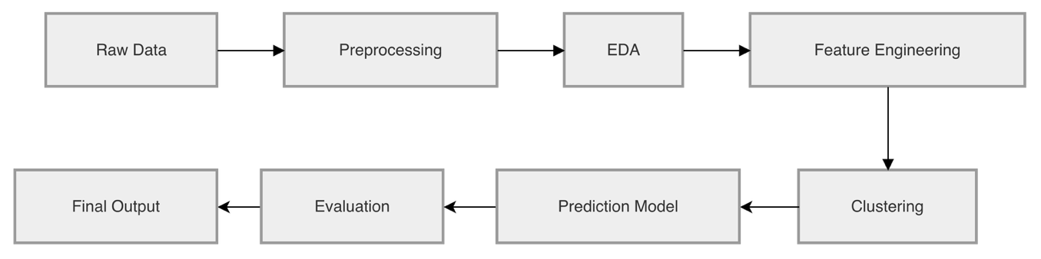
Data Preparation
Combined 54 CSV files into one dataset
Removed missing and invalid values
Converted dates into year and month
Grouped data into LSOA-month level
This step made the data ready for analysis and modelling.

Slide 7
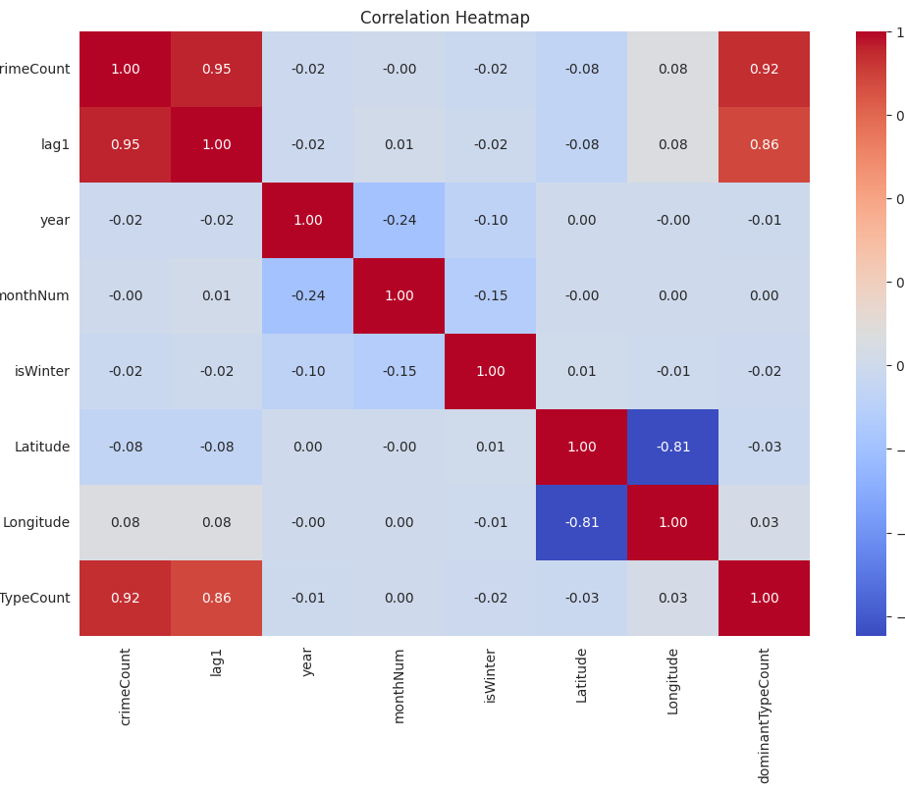
Feature Correlation Heatmap
This heatmap shows how different features are related to each other. Strong positive values (red) mean features move together, while negative values (blue) show opposite trends. It helps identify important features like lag1 and dominantTypeCount for prediction.
Notes:
Pearson Correlation Coefficient (r), which measures the linear relationship between two variables. The values always range from -1 to 1
+1.00 (Dark Red): Perfect positive correlation. As one variable goes up, the other goes up in a perfectly predictable way.
0.00 (Light Blue/Grey): No linear relationship. The variables don't seem to influence each other.
-1.00 (Dark Blue): Perfect negative correlation. As one variable goes up, the other goes down.

Slide 8
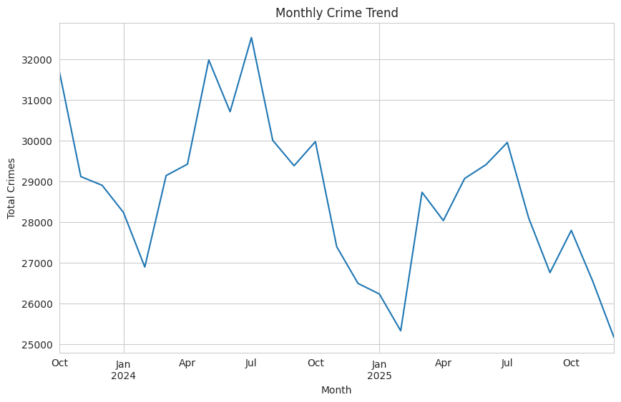
Monthly Crime Trend
This graph shows how crime levels change over time each month. Crime rises and falls, with peaks in mid-2024 and a drop in early 2025. This suggests crime follows a time-based pattern.

Slide 9
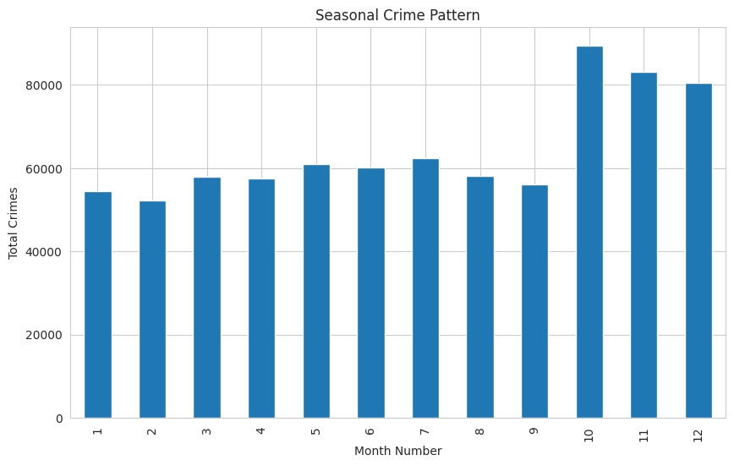
Seasonal Crime Pattern
This graph shows how crime levels vary across different months of the year. Some months, especially towards the end of the year, have higher crime rates compared to others. This indicates that crime follows a seasonal pattern.
Notes:
Crime peaks in mid-2024 and drops in early 2025.

Slide 10
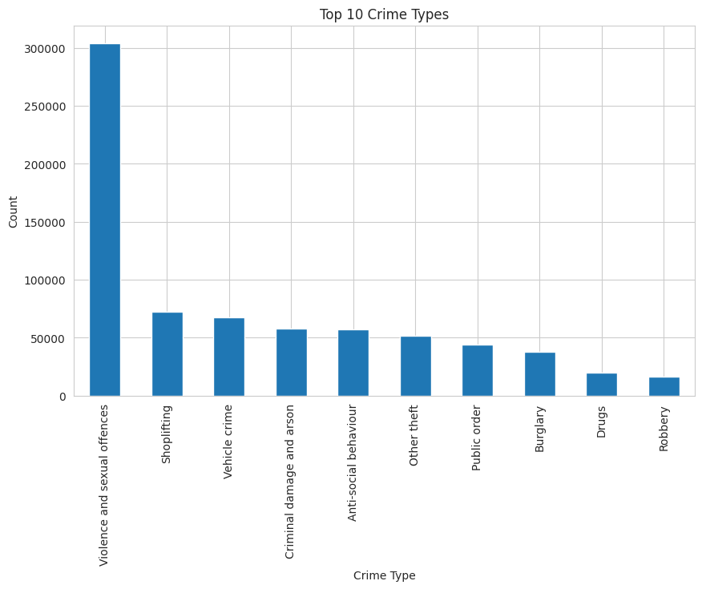
Top Crime Types
This graph shows the most common types of crime in the dataset. Violence and sexual offences have the highest count, followed by shoplifting and vehicle crime. This shows that theft-related crimes are also very frequent.

Slide 11
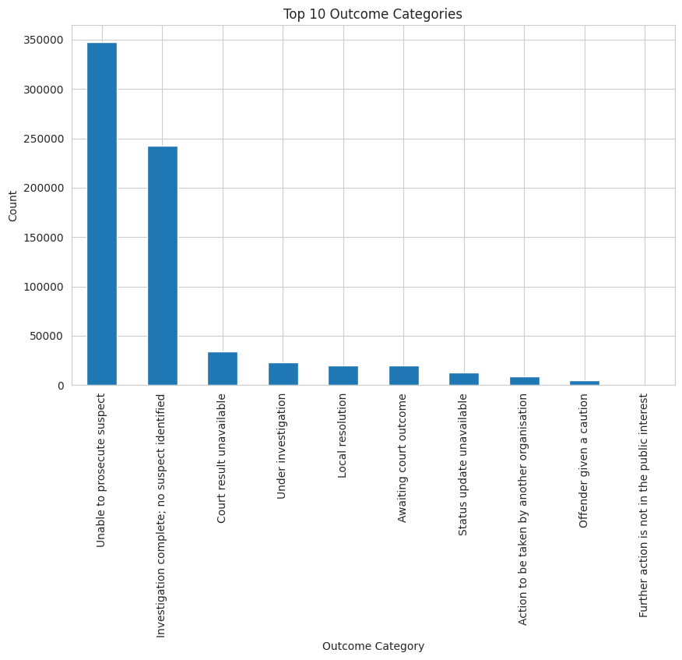
Outcome Categories
This graph shows the outcomes of reported crimes. Most cases end with no suspect identified or are unable to be prosecuted. This highlights limitations in crime resolution by police.

Slide 12
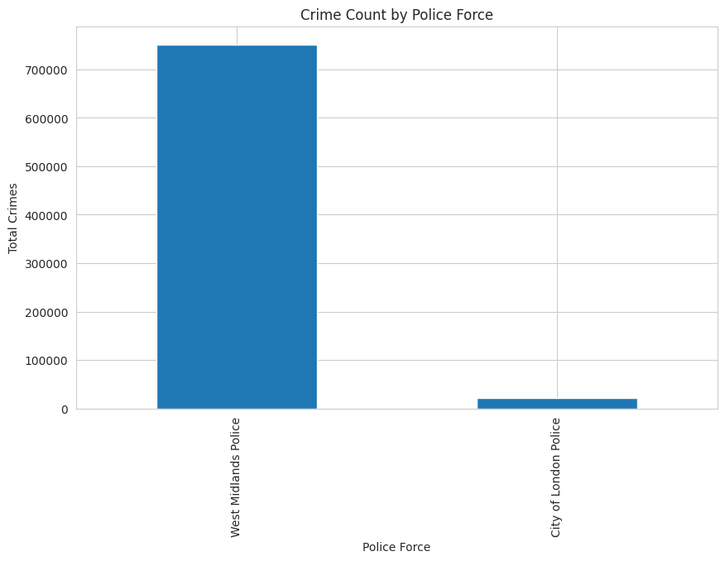
Crime Reports by Police Force
This graph shows the number of crimes reported by each police force. Most of the data comes from West Midlands Police, while City of London Police contributes a much smaller portion.

Slide 13
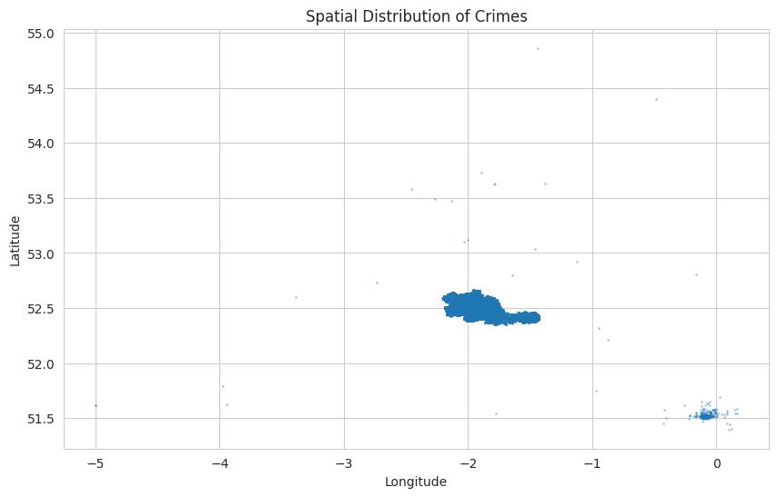
Spatial Distribution of Crime
This graph shows the spatial location of crimes using longitude (x-axis) and latitude (y-axis), where values such as 0, -1, and -2 represent geographic coordinates on the map. The points are not evenly distributed, and most crimes are concentrated in specific areas. This indicates that certain locations experience higher crime levels than others.
Notes:
Longitude (X-axis)
Moves left → west
Moves right → east
Examples:
-5 = far west (like Wales side)
-2 = central UK (Manchester area)
0 = east side (London region)
Latitude (Y-axis)
Moves down → south
Moves up → north
Examples:
51.5 = London area
52.5 = Midlands / Manchester
54+ = northern UK

Slide 14
Hotspot Detection (RQ1)
Crime is not evenly distributed.
Some areas have much higher crime levels than others.
Two clustering methods were used:
Kmeans
Groups areas into fixed clusters Based on distance/similarity
DBSCAN
Groups areas based on density Detects hotspots and outliers
Notes:
Here we answer Research Question 1: Which areas are crime hotspots? Since crime is unevenly spread, clustering helps us group similar areas and find regions with high crime concentration
What K-Means does
K-Means:
Divides data into K fixed clusters
Each cluster has a center (centroid)
Points are assigned to the nearest center
Key assumption:
Clusters are:
Circular
Similar size
Evenly distributed
What DBSCAN does
DBSCAN groups points based on density, not distance to a center.
It uses two main ideas:
Points close together → cluster
Sparse points → noise
Silhouette Score: Goodness of clustering.
how similar a data point is to its own cluster

Slide 15
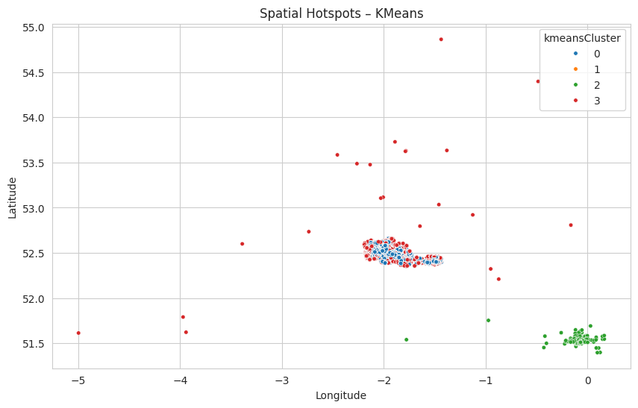
KMeans Clustering Results
Number of clusters: 4
Silhouette Score: 0.26
Key Findings:
✔ Groups locations into general regions ❌ Weak separation between clusters ❌ Does not clearly isolate extreme hotspots
Notes:
KMeans divides the data into four groups based on similarity. It gives a basic understanding of crime distribution, but the silhouette score is low, meaning the clusters are not very strong.

Slide 16
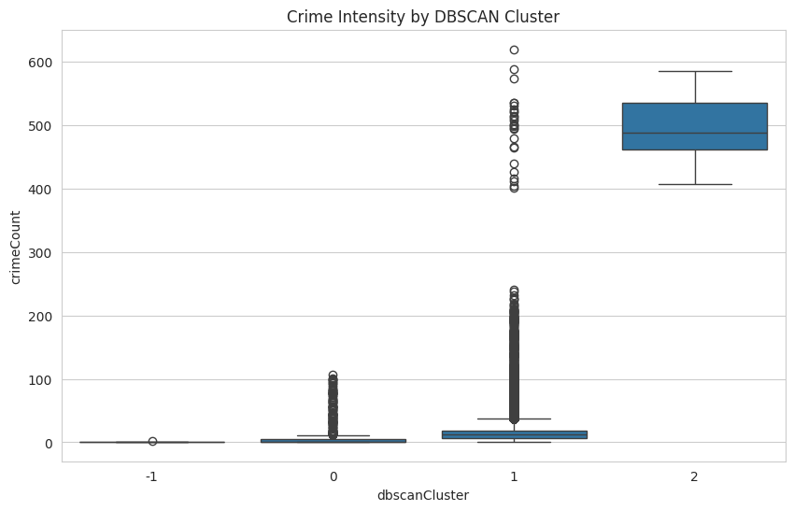
DBSCAN Hotspot Detection
Silhouette Score: 0.74
Cluster | Meaning
2 | Very High Crime Hotspots
1 | Moderate Crime Areas
0 | Low Crime Areas
-1 | Outliers / Noise
Box | Middle range of Data
Whiskers | Spread of value
Circles | Noise
Key Findings:
✔ Better cluster quality ✔ Detects dense hotspots ✔ Identifies unusual areas
Notes:
DBSCAN performed much better than KMeans. It identifies dense crime hotspots and also detects outliers. Cluster 2 clearly represents high-crime areas, while -1 shows unusual or isolated regions.”

Slide 17
Crime Prediction Models (RQ2)
We tested two models to predict future crime levels:
Model | Purpose
Linear Regression | Baseline simple model
Random Forest | Advanced non-linear model
Key takeaway:
Linear Regression checks if crime follows a simple pattern
Random Forest captures complex relationships
Notes:
For RQ2, two regression models were used: Linear Regression and Random Forest. The goal is to predict crime count for the next month based on historical and spatial features. Linear Regression provides a simple baseline by modeling linear relationships, while Random Forest captures more complex patterns and interactions in the data. This comparison helps evaluate whether crime patterns are simple or require more advanced modeling techniques.
Strengths
Simple and easy to understand
Fast
Good baseline model
Weaknesses (important)
Cannot capture complex patterns
Struggles with:
Non-linear data
Interactions between features
Sensitive to multicollinearity (you saw this in heatmap)
What it does
Random Forest is:
A collection of many decision trees
Each tree:
Makes a prediction
Final result = average of all trees

Slide 18
Model Performance & Comparison
Model | RMSE
Linear Regression | 5.35
Random Forest | 4.84
Lower RMSE = Better performance
Random Forest performs better because it handles complex patterns.
Notes:
How to understand RMSE
Lower RMSE = better model
Higher RMSE = worse model

Slide 19
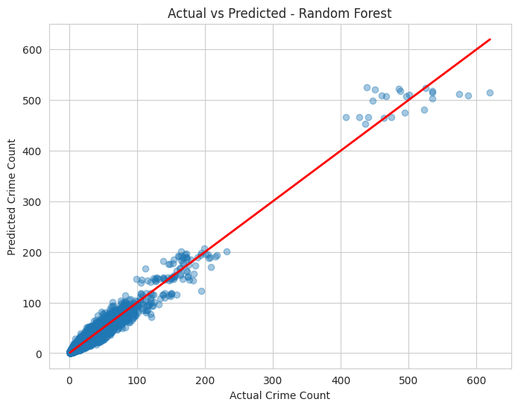
Actual vs Predicted
Most points lie close to the red line, showing good prediction accuracy.
A few points further away indicate some prediction errors, especially at higher crime values.
Notes:
This plot compares actual and predicted crime values for the Random Forest model. The red line represents perfect predictions. Most points lie close to this line, indicating strong model performance, especially for low and medium crime levels. However, at higher crime values, the points are more spread out and often fall below the line, showing that the model tends to underestimate extreme cases. This suggests that while the model performs well overall, predicting very high crime levels remains more challenging.

Slide 20
Overfitting Analysis
Metric | Value
Train RMSE | 1.83
Test RMSE | 4.84
Big gap → overfitting
The model performs much better on training data. This shows overfitting.
Notes:
The model performed very well on training data but worse on unseen data, meaning it was overfitting

Slide 21
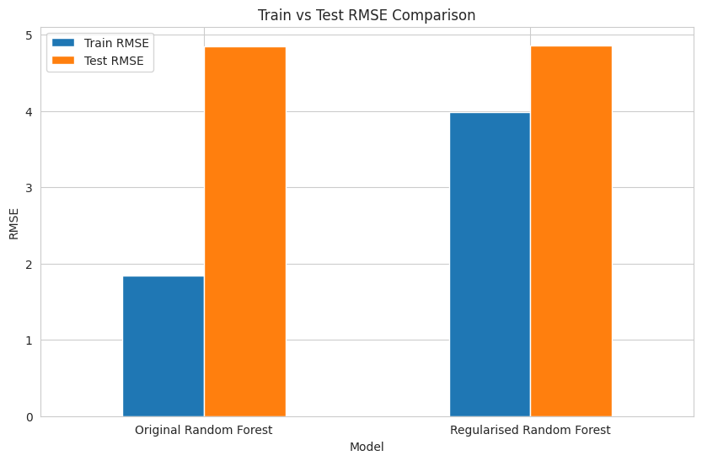
Model Improvement
Regularisation & Hyperparameter Tuning
Model Version | RMSE
Initial RF | 4.84
Regularised RF | 4.85
Tuned RF | 4.62
Key takeaway:
Final tuned model performed best.
Notes:
We tested → We compared → We validated → We found issue → We improved it
Regularisation means:
Limiting tree depth
Reducing splits
Making trees less complex
So instead of memorising data, the model:
Learns more general patterns
Your results
Before (Overfitting slide)
Train RMSE = 1.83
Test RMSE = 4.84
👉 Big gap → overfitting
After Regularisation
Train RMSE = 3.98
Test RMSE = 4.85

Slide 22
Hyperparameter Tuning
Initial Random Forest
RMSE: 4.84
Baseline model without tuning
Regularised Random Forest
RMSE: ~4.86
No clear improvement
Hyperparameter Tuning (Randomised Search)
Tuned: tree depth, estimators, split size
Used cross-validation for better selection
Final Tuned Model
RMSE: 4.62
Best performance achieved
More accurate and generalised model

Slide 23
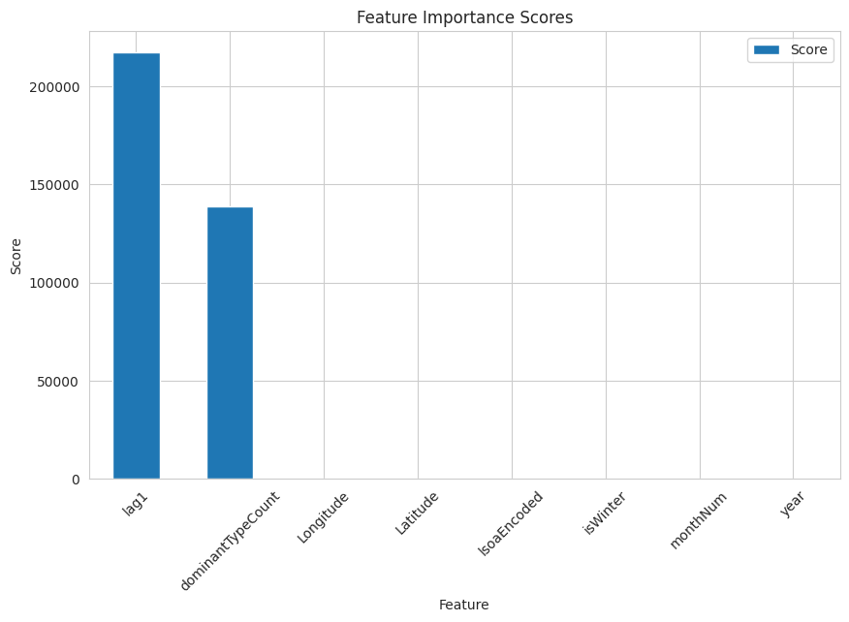
Feature Importance (RQ3)
Top features:
Previous crime (lag1)
Dominant crime type
Location
Previous crime is the most important factor.
Notes:
The feature importance results show that the most influential factor in predicting crime is the previous crime count (lag1), indicating strong temporal dependency. The dominant crime type and location features also contribute significantly, reflecting spatial clustering and crime patterns. Other features such as month, year, and seasonal indicators have relatively low importance, suggesting they have a weaker direct impact on crime prediction.

Slide 24
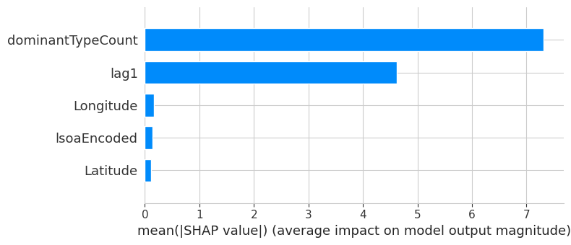
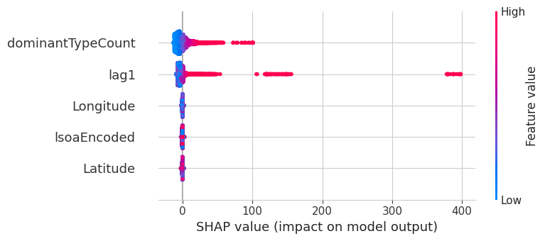
SHAP Analysis
How exactly does each feature influence the model’s predictions?
This figure shows SHAP analysis using two plots. The left plot shows how each feature affects individual predictions, while the right plot shows overall feature importance. It is clear that dominant crime type and past crime (lag1) have the highest impact on predictions, while location features have a smaller effect.
Notes:
(SHapley Additive exPlanations). SHAP explains how much each feature pushes a prediction up or down.
The SHAP analysis provides a detailed explanation of how each feature influences predictions. The summary plot shows that higher values of dominant crime type and previous crime significantly increase predicted crime levels. The global importance plot confirms that these features have the largest overall impact, while location features contribute less. This demonstrates that both temporal and crime-type factors are the main drivers of the model’s predictions.

Slide 25
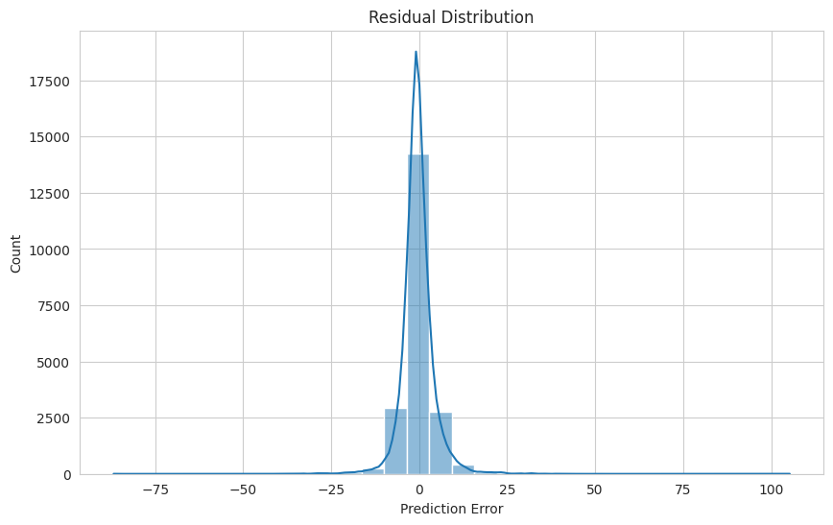
Model Validation
Are the model errors reasonable and well-behaved?
✔ Most errors are close to zero
✔ Predictions are generally accurate
✔ Model is stable and reliable
Notes:
Symmetrical shape
The graph looks roughly balanced:
Errors on left (negative)
Errors on right (positive)
Meaning:
Model is not biased (not always over or under predicting)
Good model behaviour
Ideal residual distribution should be:
Centered at zero ✅
Symmetrical ✅
Narrow spread ✅
Residual = 0 → perfect prediction
Positive residual → model underpredicted
Negative residual → model overpredicted

Slide 26
Function – predictNextMonthCrime
Predicts next month’s crime for a given location
Accepts input: area name, street, or coordinates
Matches input to LSOA area
Uses trained model to estimate crime count
Assigns a risk level (Low, Medium, High, Very High)
Notes:
At the end of the notebook, I created reusable functions so the trained model can be used without running the full notebook again.
The model is saved using joblib, along with supporting lookup data such as LSOA rows, street names, feature columns, and risk thresholds.
The main function, predictNextMonthCrime, accepts inputs like LSOA code, street name, query, or coordinates. It finds the correct LSOA, builds the same feature structure used during training, predicts next month’s crime count, and returns a risk level such as Low, Moderate, High, or Very High.

Slide 27
Real World Example
Example 1:
Location: Chancery Lane
Predicted crime: 3.7
Risk level: Low
Example 2:
High crime area
Predicted crime: 490
Risk level: Very High
Shows how the system can be used in real life
Helps users quickly understand crime risk in different areas

Slide 28
Practical Use
Police:
Plan patrol routes
Focus on high-risk areas
Public:
Check safety before renting
Government:
Improve safety planning

Slide 29
Conclusion
DBSCAN is best for hotspot detection. Random Forest is best for prediction.
Past crime and location are the most important features.
This system can support real-world decision making.

Slide 30
THANK YOU FOR
YOUR TIME TODAY

